Slide 1
LIBRARY MANAGEMENT SYSTEM
Submitted by
Name:-Dhruv Goyal
Sec/Roll no.:-G/17
University Roll No:-2018789
Mentor Name:- Ms. Tanusha Mittal

Slide 2
Introduction
A Library Management System (LMS) is a comprehensive software solution designed to efficiently manage and organize library resources, processes, and services. It offers librarians and library staff a centralized platform to streamline tasks such as cataloging, circulation, patron management, and resource tracking. LMS enables users to access and borrow books, journals, multimedia, and other materials seamlessly, promoting an enhanced user experience. With its user-friendly interface and advanced features, an LMS significantly improves library operations, facilitates quick information retrieval, reduces manual errors, and enhances overall productivity .The aim of this report is to present the development process of a library management system using PHP and my sql .
MySQL is known for its high performance, scalability, and reliability, allowing learners to test their knowledge in an engaging manner. PHP is a widely-used server-side scripting language, specifically designed for web development. It allows developers to create dynamic and interactive web pages that can generate content easily. PHP seamlessly integrates with various databases, including MySQL, making it an ideal choice for web applications that require efficient data handling and storage.

Slide 3
Continued
In combination, MySQL and PHP form a powerful duo for web development, where PHP handles server-side scripting and generates dynamic content, while MySQL manages the database, ensuring efficient data storage and retrieval.
Problem Statement:
TO CREATE A LIBRARY MANAGEMENT SYSTEM SO THAT IT CAN HANDLE USERS DATA.
Example: Books issued, registration , number of books etc.

Slide 4
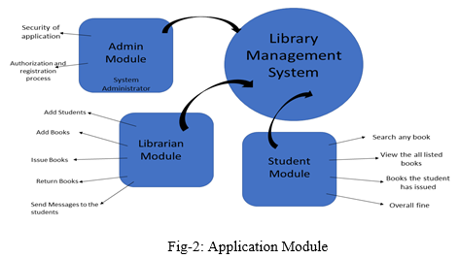
Methodology
This project contains admin and user modules.

Slide 5
User Module
Design user registration and login functionality for access.
Create user profile management for updating information and preferences.
Implement book borrowing, returning, renewal features for users.
Develop search and browse catalog functions to help users discover books.
Ensure privacy and security measures to protect user data in the database.
Integrate the user module with the overall Library Management System.

Slide 6
Admin/Librarian module
Design librarian registration and login functionality for staff access.
Create librarian dashboard with administrative privileges and controls.
Implement book cataloging, editing, and inventory management features.
Set up book circulation system to track loans, returns, and reservations.
Develop user management tools to handle patron accounts and fines.
Integrate reporting and analytics features for data-driven decision-making.
Ensure security measures for protecting sensitive librarian-related data.
Integrate the librarian module with the overall Library Management System.

Slide 7
Result and Discussion
The Library Management System is a web-based database system that allows librarian to enter users data like keeping a record of books issued.
It provides a user-friendly easy interface using CSS , php , java-script bootstrap to enhance user experience.

Slide 8
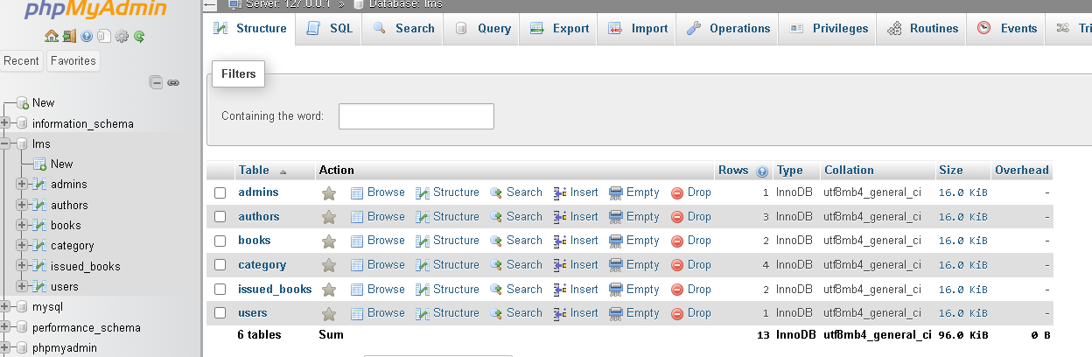
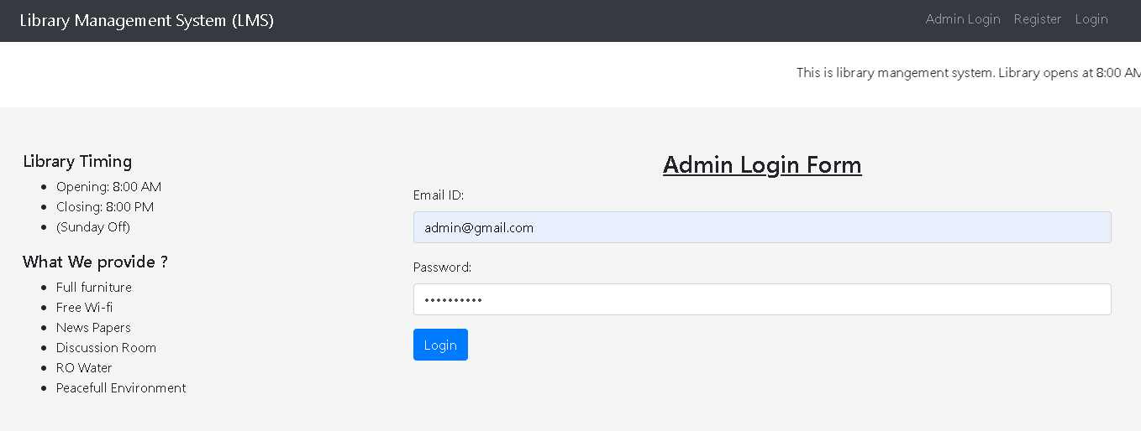

Slide 9
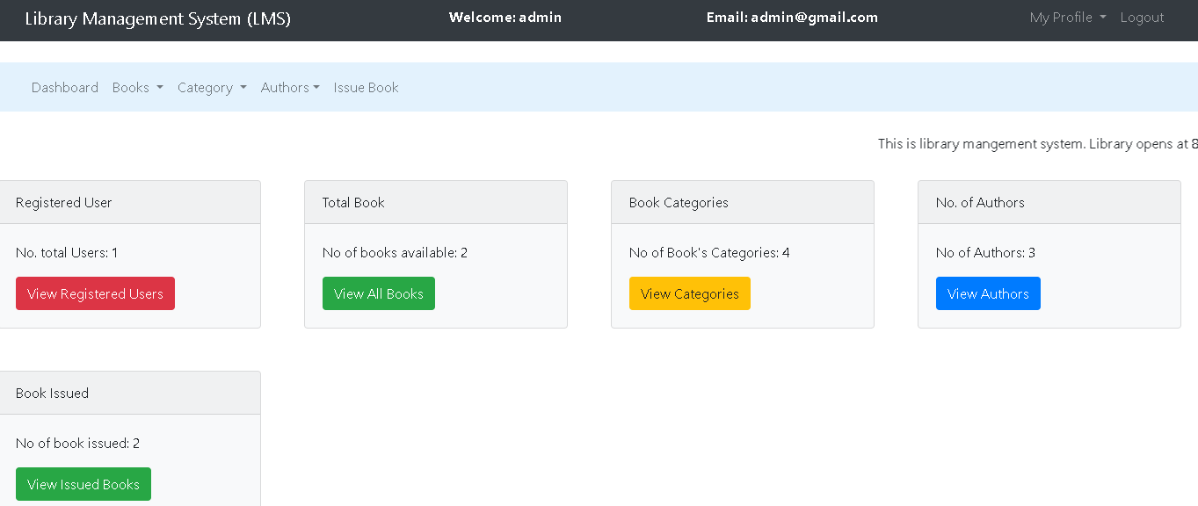

Slide 10
Conclusion and Future-Work
In conclusion, The project demonstrates effective utilization of PHP and my sql components to create an intuitive and engaging library management system.
While the application fulfills its core purpose, there is room for future enhancements and improvements like:-
Expand the Database: Increase the number of entries present and then use a function to calculate the fine if the days of book issued exceeds..
Adding a mail system: To ensure that users submit the issued books on time .A mail system should be added to the database.

Slide 11
THANK YOU

